Slide 1

Rabbit Rescue!!
Game Designers Meadow Greenlee and Jeremy Hepker

Slide 2



Game Synopsis
The Honorable Rabbit King has been captured by the dreaded Snake King! It is your job to defeat the snake
King and save the royal
Rabbit family!
HAHAHAHA!

Slide 3
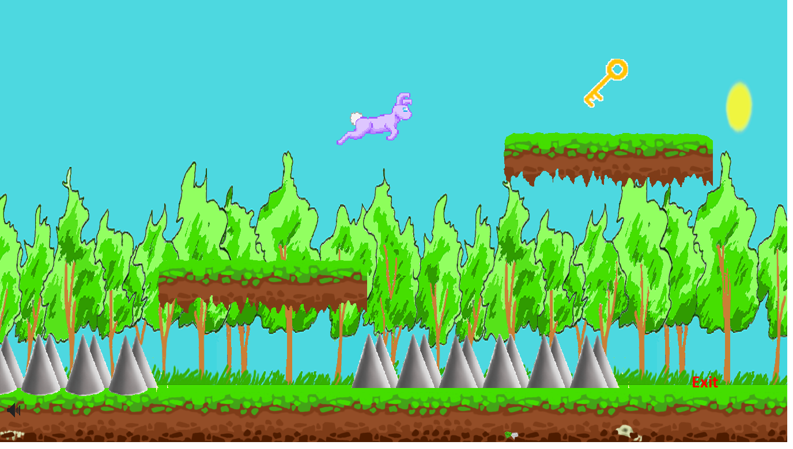
What is the goal?
The goal of the game is go through each level and find a key that will free a member of the Royal Bunny Family! The bunny in need of rescuing will be stuck in a cage at the end of each level!

Slide 4
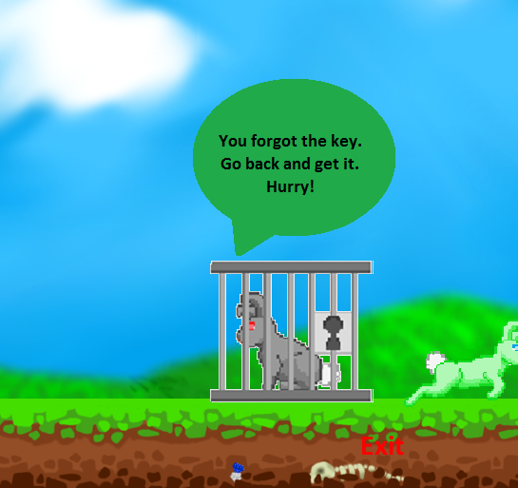
Don’t Forget the Key!!
If you reach the end of the level and you have forgotten the key the captured bunny will tell you to go back and get the key!

Slide 5
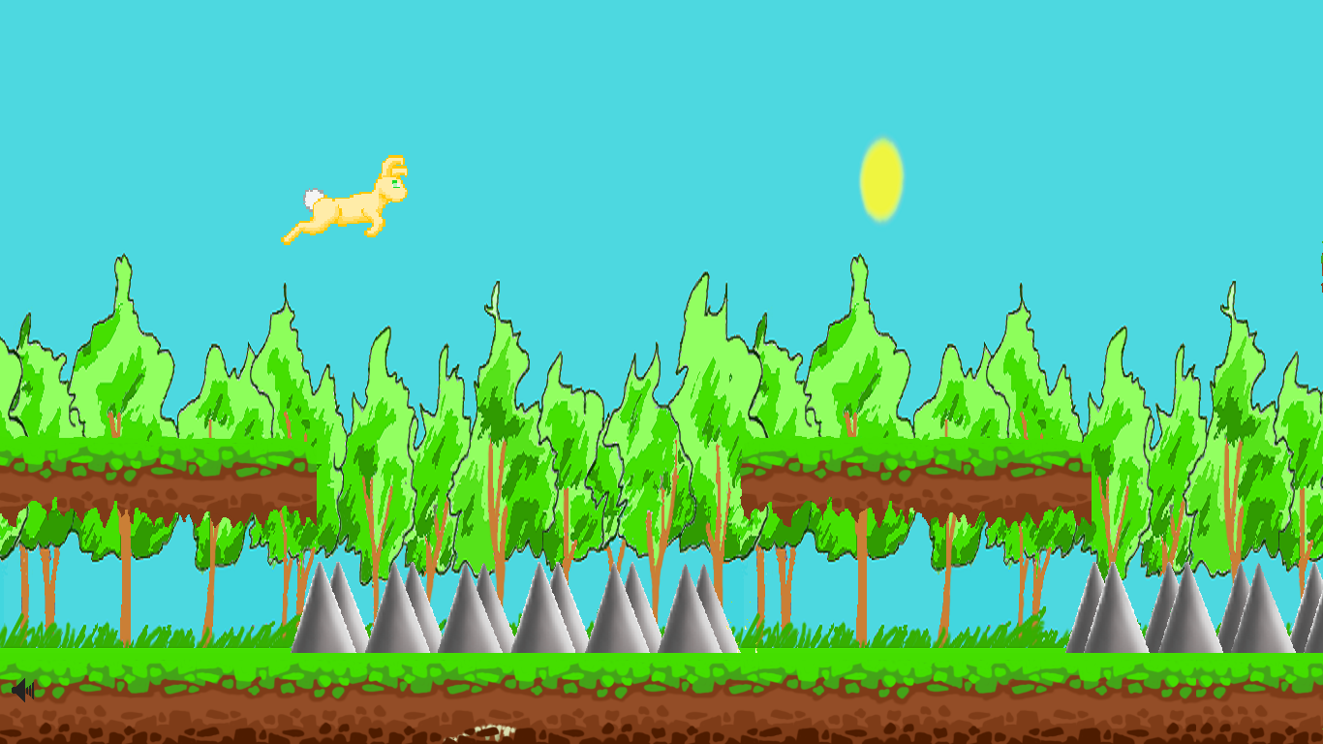
Avoid Danger!!
Throughout the game there are many enemies and obstacles to avoid. Don’t die!!

Slide 6
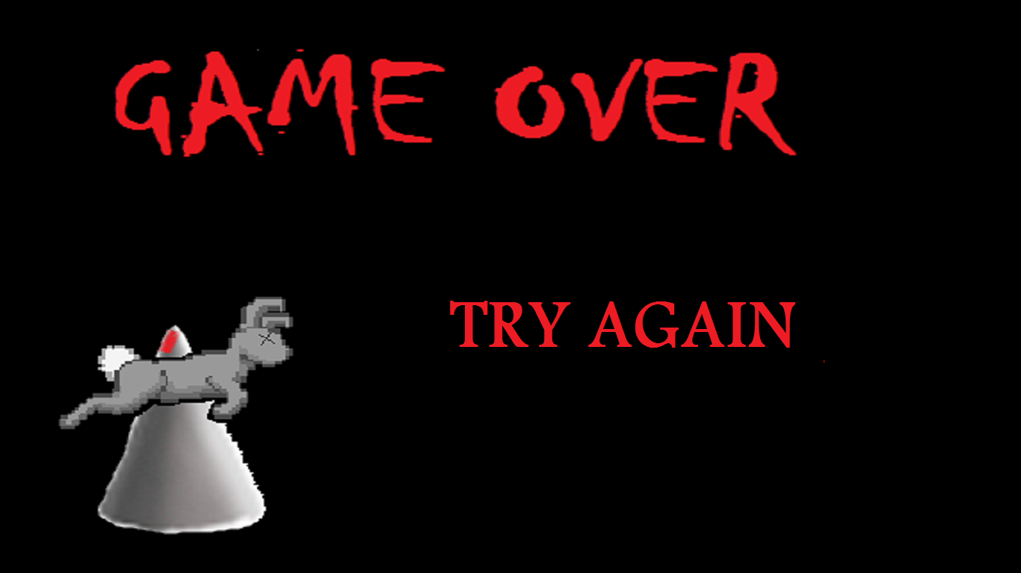
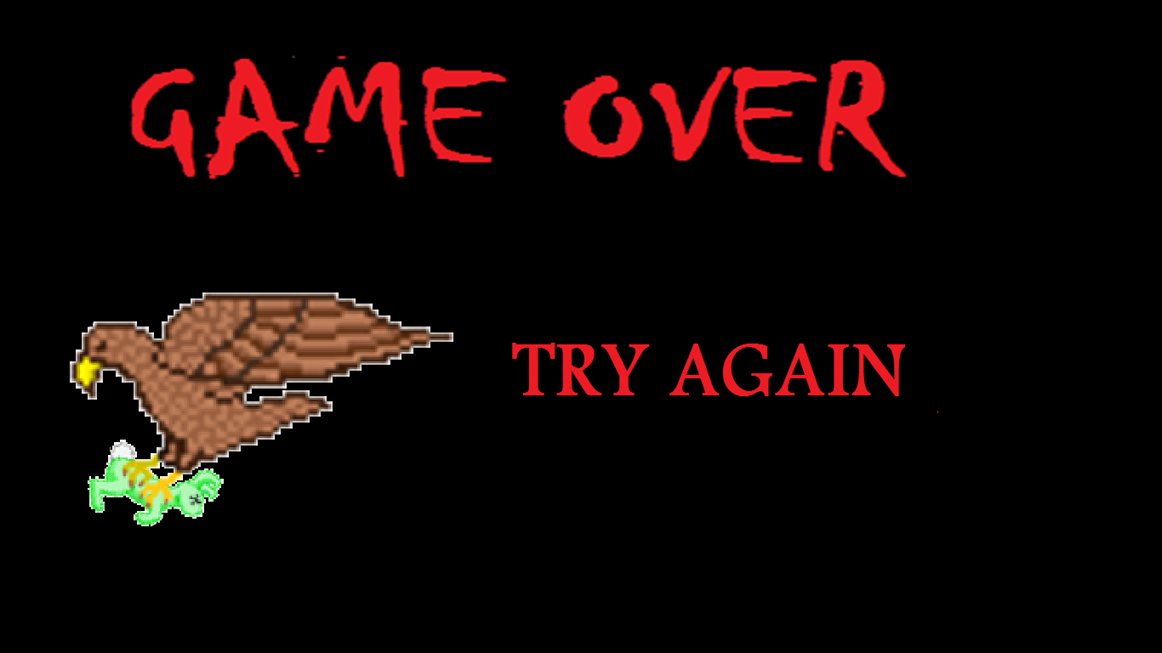
If you Die…
If you accidently meet your untimely demise don’t worry! Just hit try again and continue your mission!

Slide 7
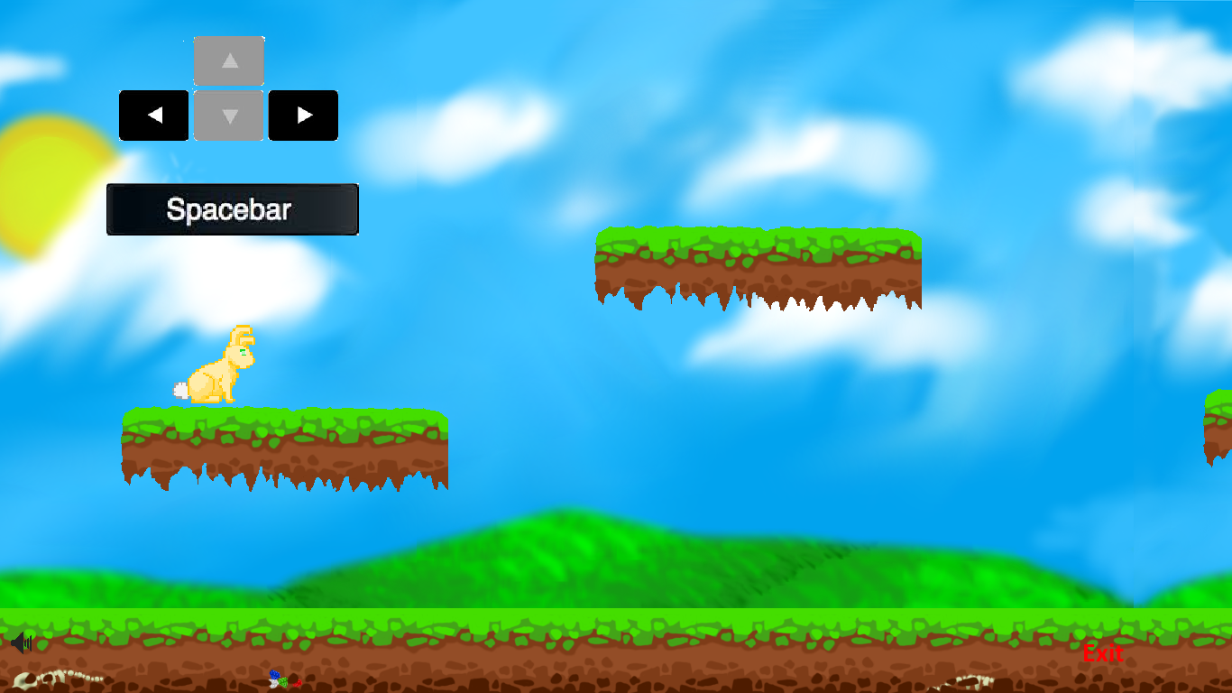
Controls!
Rabbit Rescue has very simple game controls! Just use the left and right arrow keys to move and the spacebar to jump!
Hint: Hit the spacebar quickly twice to double jump.

Slide 8
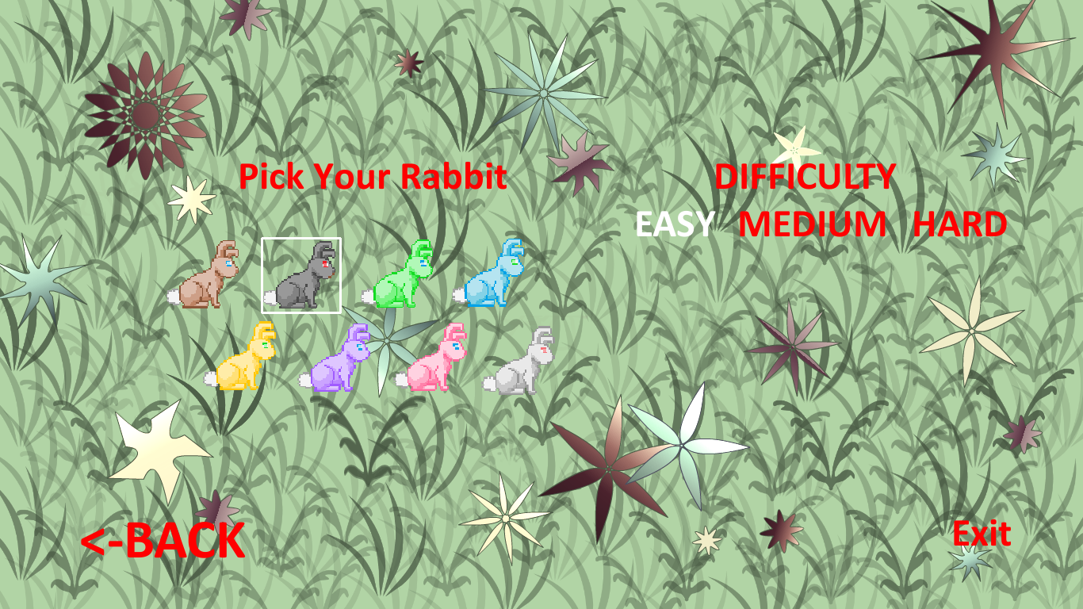
Cool Features!
Rabbit Rescue has several cool features! You, the player, have the ability to choose the color of their bunny and the difficulty of the game! Just hit the settings button before you start the game!

Slide 9


Have Fun!
Its time to play the game! Enjoy!

